Slide 1
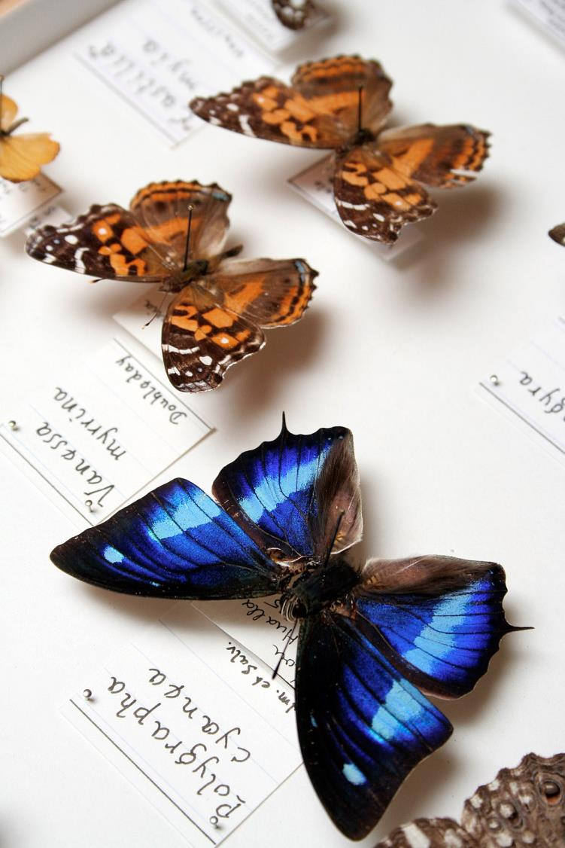























©Natural History Museum London – CC BY
Alex Hardisty
DiSSCo Technical Team
Director of Informatics Projects
Cardiff University, United Kingdom
@AlexHardisty
FAIR Digital Objects as Basic Design Choice and the Need for PIDs
Acknowledge: Dimitris Koureas, DiSSCo Coordinator
Naturalis Biodiversity Center, Netherlands

Slide 2
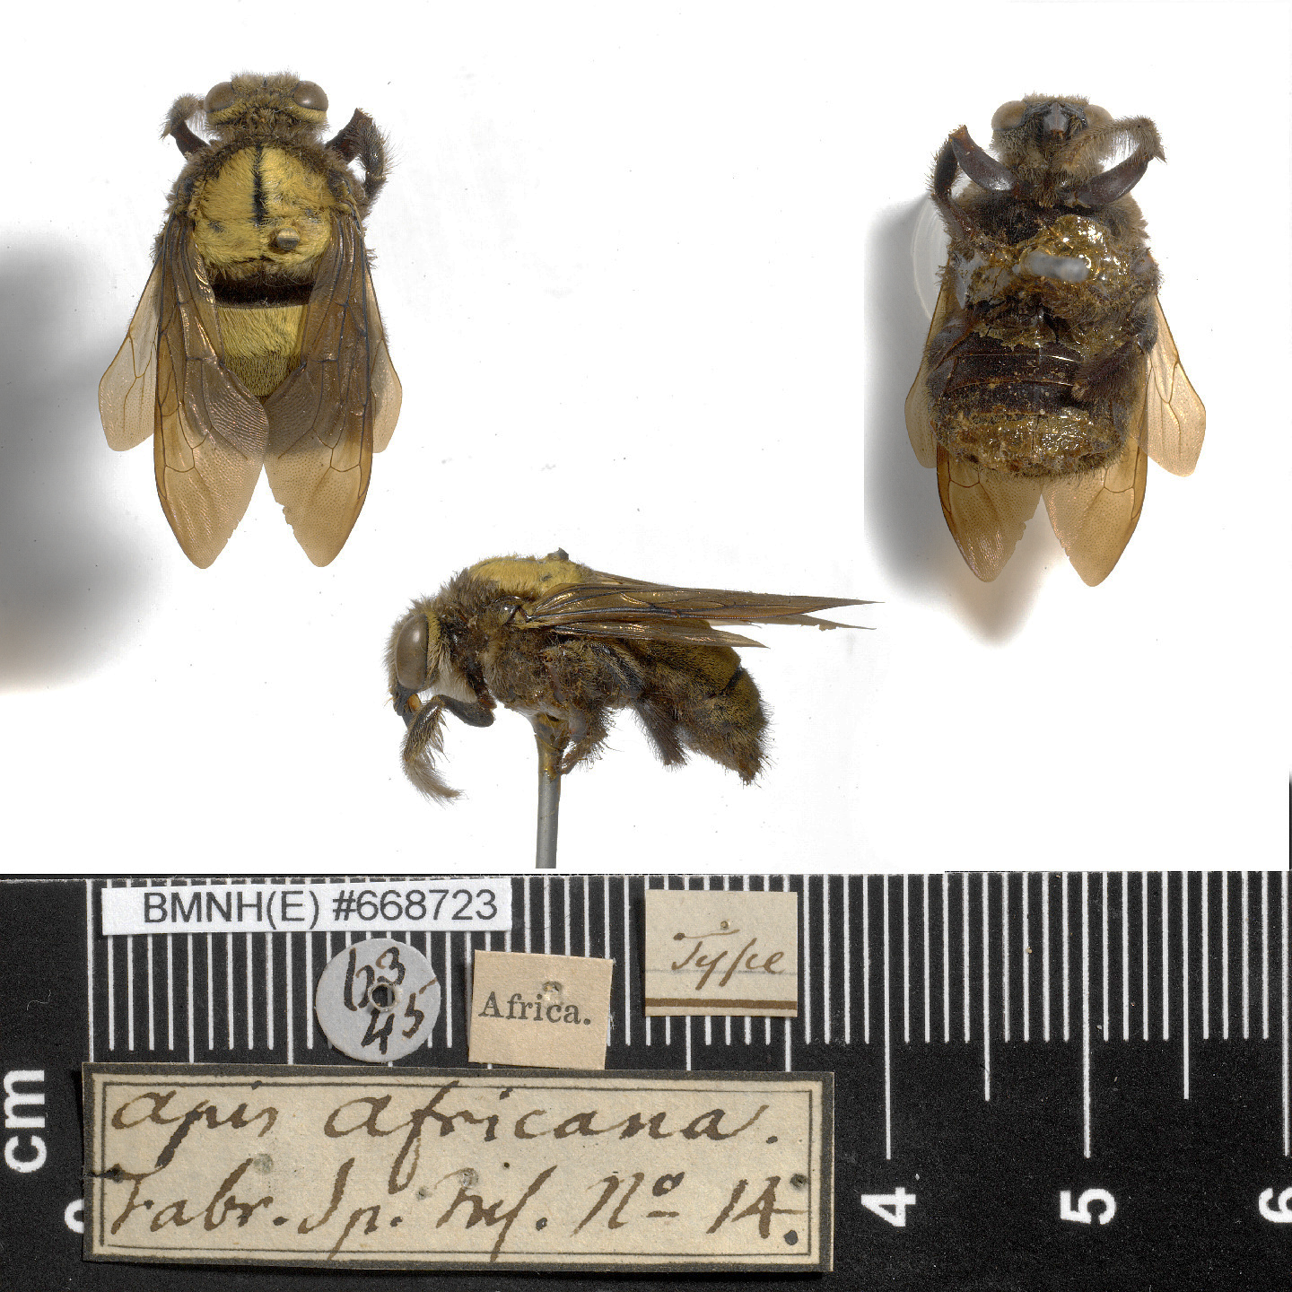
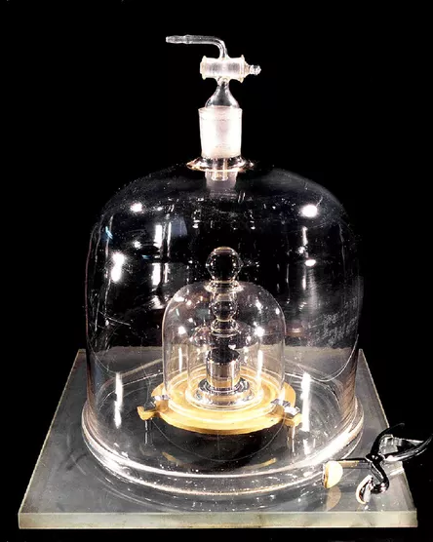
BMNH(E)668723
Apis africana
Type specimen = Standard
Natural Science Collections:
10 million standards
3 billion objects

Slide 3
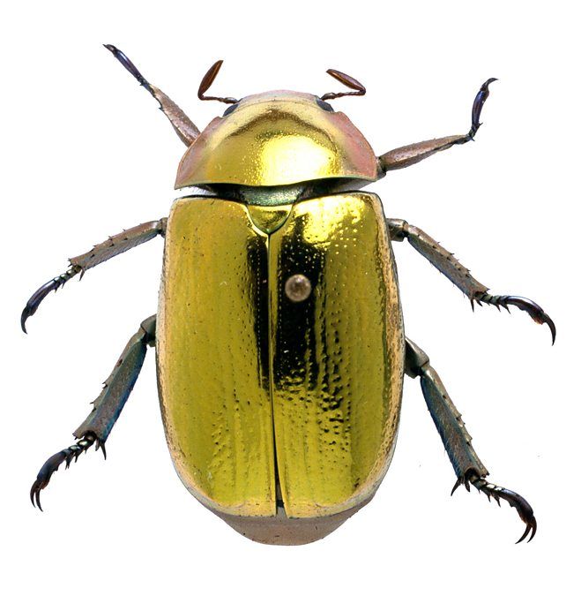




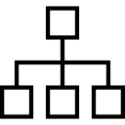


What’s in a Museum specimen?
Genomic data
Biochemical data
Morphological data
Geographical data
Taxonomic Information
Species Interactions data
Ecological data

Slide 4


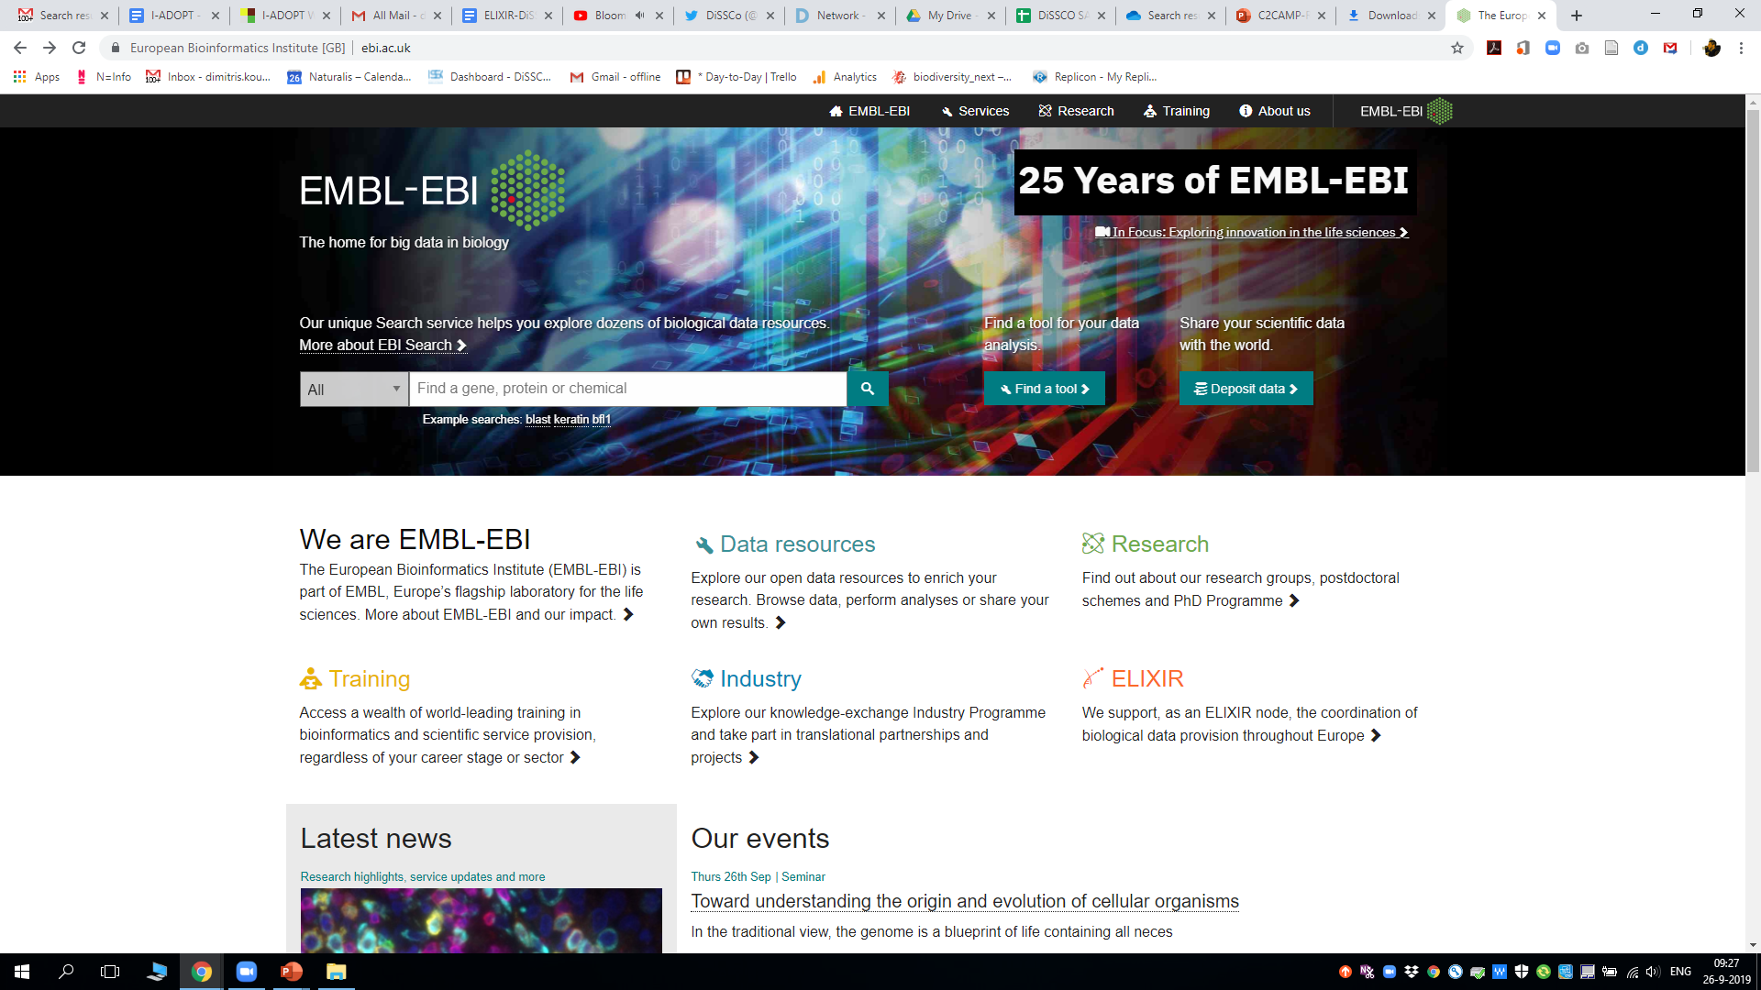
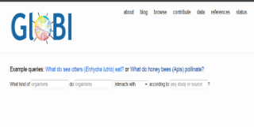

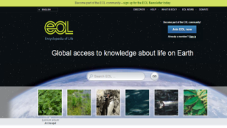
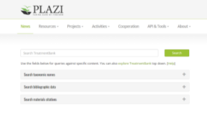
GBIF
Collections-related Data classes
Catalogue of LIfe
Occurrence / Images
Taxonomy
EMBL-EBI
GloBI
Species Interactions
Genomic information
Literature - Treatments
Traits
Plazi – TreatmentBank
Nomenclature
EoL - TraitBank
IPNI / Zoobank

Slide 5
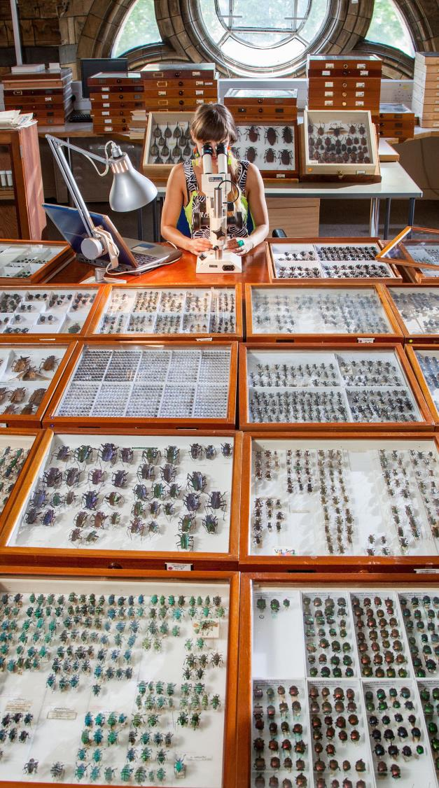
Extended Specimens (Digital Specimen objects)
Taxon
Interaction
Sequence
Occurrence
Taxon
Concept
All data classes unambiguously linked to the physical objects they derive from
Gene
Specimen
Taxon Name
Collection
Trait
Publication

Slide 6
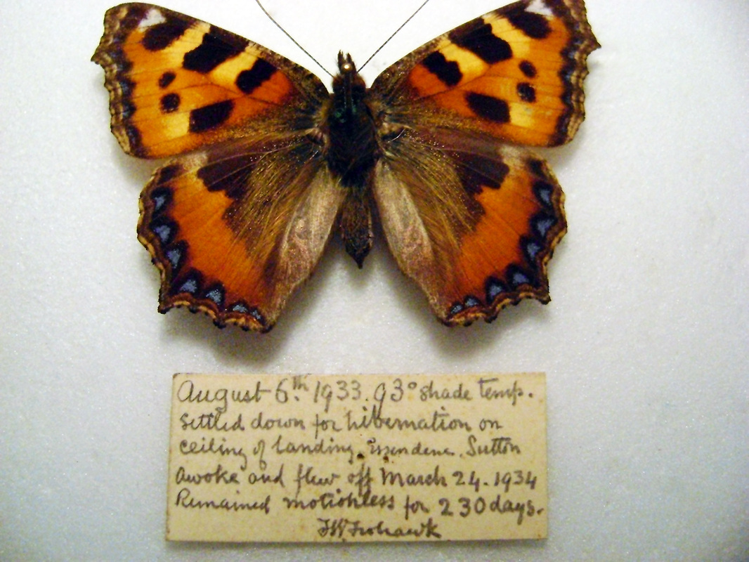
Structure of a Digital Specimen Digital Object (DSDO)
DO, = An envelope
PID
Kernel information (metadata about specimen DO)
metadata₂
… … … … … … …
… … … … … … …
metadata_{N}
… … … … … … …
content_{N}
… … … … … … …
… … … … … … …
… … … … … … …
… … … … … … …
… … … … … … …
PID₁
PID₂
PID…
PID_{N}
Bit sequence
PIDs are pointers that resolve to location of the item e.g., DO itself, physical specimen, hi-res images, label information, tissue sample, DNA sequence, etc.

Slide 7
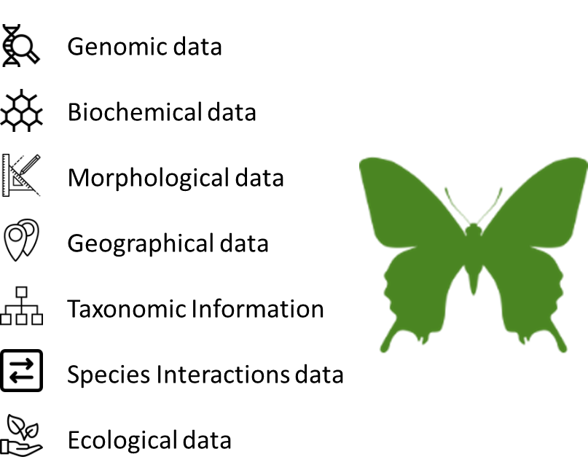
Physical Object
Digital Surrogate
FAIR Digital Object
An actionable knowledge unit

Slide 8


Unique benefits of implementing a FAIR DO Architecture in Natural Sciences
Trust
Reproducibility
Persistent link to the specimen supports validation of observations
Persistent link to the specimen supports validation of observations
New insights
Expert Community
Robust linking of different data types
Community Annotations -
Move the curation space from the analogue to the digital

Slide 9
What we need to do still to grow a FAIR DOA
Scalable and agile PID
Solutions
Data Type Registries
FAIR DO compliant repositories
Stakeholder Buy-in
Capacity building
Journal article: FAIR Data and Services in Biodiversity Science and Geoscience
Larry Lannom (CNRI), Dimitris Koureas (Naturalis) and Alex R. Hardisty (Cardiff University)
Data Intelligence 2(2020), 122–130. doi: 10.1162/dint_a_00034. First online 28Oct2019: http://bit.ly/DOAforFAIR

Slide 10
What we need from a PID service
Resilience
DiSSCo needs 20 – 30 billion PIDs over next two decades. Globally, 10x that number.
PIDs resolvable (sustained) for long-term (aim for 100+ years).
Trust in the service
Own brand control: ‘NN.’ top-level prefix instantly recognizable as specimen/collection.
Natural Sciences Identifier – NSId, nsid
Avoidance of confusion e.g., with DOI, IGSN, ePIC, etc.
Equal party to the governance.
Global provision – not only for European institutions and users.
Short PIDs/auto PID shortening for human use and in publications
Especially for objects central to success (i.e., digital specimen and collection objects).
128-bit uuid not human friendly but acceptable for machine processing.
Ease of use
No fee at point of use (not for minting, not for resolution).
Resolution via all well-known resolvers (e.g., doi.org, hdl.handle.net).

Slide 11
What we need, continued
Multiple types of object to register
At present, at least 25
Requiring different classes of PID with separate 2nd-level prefixes
Examples:
PIDs for specimen & collection things (prefix per registration agency, .1000 – .9999)
PIDS for transaction types (up to 10 classes, .990 – .999)
Other PID classes, including concepts (to be defined, .600 – .799)
Temporary PIDs (.888)
Decoupling of types from PIDs
Mustn’t be limited to the type definitions offered by a PID provider
Flexibility to vary/extend PID record (kernel) information
For different object types – elevate some metadata to kernel information
For Crossref-style and other services over objects, including search in PID records

